Slide 1


XML and TEI
Part 1: Introduction to XML
Adapted from the Women Writers Project
Notes:
This is a gentle introduction adapted from several longer course I have taken. It is not meant to be comprehensive. Part 1 is designed to introduce you to the basic concepts of xml.

Slide 2
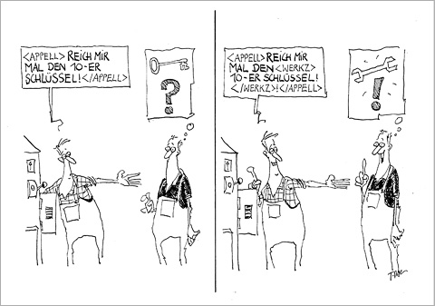
Xml as a means of structuring information
One way to understand what XML is and why it is important is to think about it as a way of structuring or organizing information.
Structure is what makes digital information useful to us; it helps us find things, it helps us identify them and understand what they are, and it helps us communicate about them to other people.
Notes:
The eXtensible Markup Language (XML) is a markup language that defines a set of rules for encoding documents that is both human and machine-readable. That is, XML is a standard for constructing your tags that describes the structure of a document, rather than just its appearance. It is a simple, flexible and customizable.
A markup language is a system for annotating a document that is syntactically distinguishable from the text.

Slide 3
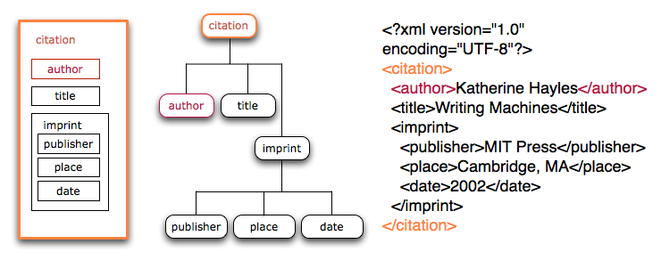
Xml as a means of structuring information
Notes:
XML provides a very specific way of structuring information and of looking at the world. It asks us to identify pieces of information that we are interested in, and it asks us to group them together. We can represent these groupings in various different visual ways, all of which represent the same thing—XML’s structure. The first useful metaphor is that of a set of nested boxes, like in the example on the left. These boxes always nest perfectly within each other, and do not overlap. You can also think about the structure of XML as being like a tree, as in the middle example. Each XML document is a complete tree, and each XML element is like a branch of that tree. The example on the right shows XML as it is written, using a system of tags that mark the boundaries of the boxes and the structural groupings that make up the informational system. Each box or tree node (or element in XML parlance) is represented by a pair of tags that mark its beginning and its end, and these elements can be nested inside one another.

Slide 4
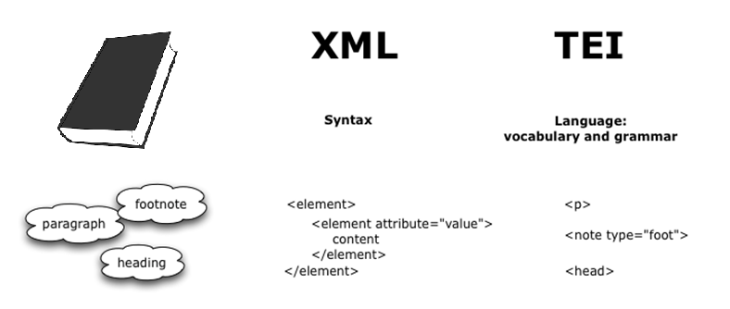
The relationship between TEI and xml
XML defines a syntax for text encoding. It is a method for distinguishing our markup from the content that we are marking up.
TEI provides the specifics of the actual encoding language. It translates our concepts into XML, and provides a controlled vocabulary that we use in marking up the text.
Notes:
Today we will mostly be looking at the syntax of xml, and the rules for creating xml documents.

Slide 5
So what does this Realy look like….
Namespace declaration
Root element
<?xml version="1.0" encoding="UTF-8"?>
<TEI xmlns="http://www.tei-c.org/ns/1.0" xmlns:xi="http://www.w3.org/2001/XInclude">
<teiHeader>
<fileDesc>
<titleStmt>
<title>MD.Balt.JHU.L.119c</title>
</titleStmt>
<!—publicationStmt start here -->
<publicationStmt>
<authority>Brown University &amp;Tufts University</authority>
<idno type="USEpigraphy" xml:id="MD.Balt.JHU.L.119c">Repeat USEP ID</idno>
</publicationStmt>
[…..]
Comment
Entity Ref
Attribute
Tag
Attribute Value
Notes:
Note the root element. This is absolutely necessary to create xml.

Slide 6
Let’s Break that down

Slide 7
A Quick word about Namespaces
books.xm
<book>
<title>Collected fictions</title>
<author>Jorge Luis Borges</author>
<publisher>Penguin Books</publisher>
<date>1999</date>
<id>PQ7797.B635 A24 1998</id>
</book>
authors.xml
<author>
<title>Collected fictions</title>
<first_name>Jorge</first_name>
<last_name>Borges</last_name>
<date>1899-1986</date>
<id>79007035</id>
</authors>
Namespaces allow us to disambiguate like things
Notes:
An XML namespace is a collection of element and attribute names names uniquely identified by an explicit or implicit association to a Universal Resource Identifier (usually a url) Namespaces are invoked to differentiate elements and attributes that have the same name but different meanings and different origins. Lets say we have the two documents, and notice how they share two elements: date & id, which are used differently in each context. What if we want to integrate the information? In other words, how would we be able to distinguish between our elements.

Slide 8
A Quick word about Namespaces
<?xml version="1.0" encoding="UTF-8"?> <authors xmlns="http://www.alex.org/authors/" xmlns:book="http://www.may.edu/books"> <first_name>Jorge</first_name> <last_name>Borges</last_name> <date>1899-1986</date> <id>79007035</id> <book:book> <book:title>Collected fictions</book:title> <book:date>1999</book:date> <book:id>PQ7797.B635 A24 1998</book:id> </book:book> </authors>
Here are two namespace declarations. One is the default (the one without the prefix) and the other is explicitly prefixed
Notes:
Although a namespace usually looks like a URL, that doesn't mean that one must be connected to the Internet to actually declare and use namespaces. Rather, the namespace is intended to serve as a virtual "container" for vocabulary and un-displayed content that can be shared in the Internet space. Typing the namespace URL in a browser doesn't mean it would show all the elements and attributes in that namespace; it's just a concept. So why is the URI in the form of a URL? The idea is that URLs are typically used because in webspace URLs are unique. But always remember that they are names, not locations! Namespaces are crucial to xslt because they are what will allow us to distinguish XSLT instructions for the other elements we want to appear in our results document.

Slide 9
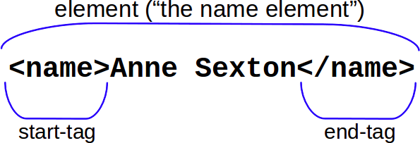
Elements, Tags and attributes
In XML, we mark the boundaries of elements with tags. These also serve as a label for the element. We should also note that tags in XML are not just important for us as readers (serving as human-readable labels for the features we choose to mark). XML tags are also important for the processor. The brackets and the forward-slashes serve to delimit the element, and allow the processor to differentiate elements from the content.

Slide 10
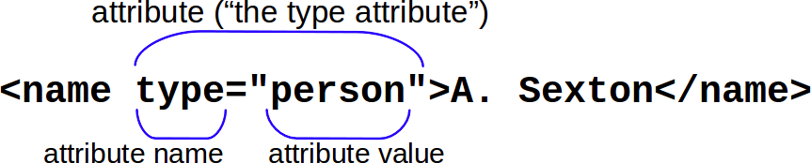
Elements, Tags and attributes
An XML attribute is like an adjective to the element’s noun, in that it modifies an element. However, attributes are a bit more detailed than adjectives. They tell you what aspect of the element they’re describing, like its type, or its size, or its color (the name of the attribute) and the specific descriptor within that category of information (the attribute value).

Slide 11
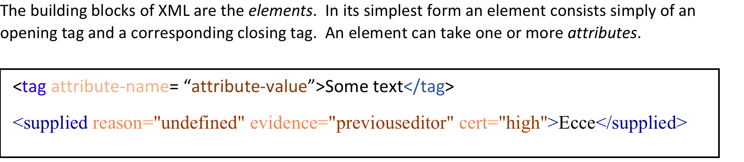
recap
Notes:
Elements and attribute names must follow these rules:
They may contain letters, numbers, ideographs
They may not contain white space, or punctuation other than hyphen, period, and underscore
They must begin with a letter or underscore.

Slide 12
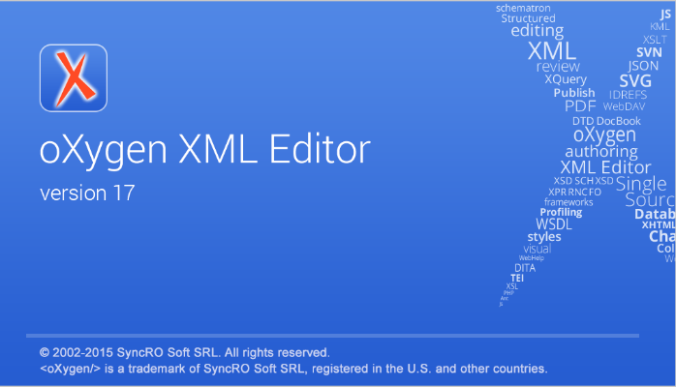
Let’s try it out

Slide 13
Xml in detail
XML representation has order: an XML document is an ordered sequence of elements. XML elements can also nest inside each other, as in the document here.
You’ll notice that in this example, we are taking certain concepts about literature and making them explicit through markup. Unless we had very good natural language processing, our computers would probably not be able to recognize that the work above is a sonnet (more specifically a Shakespearean sonnet), so we need to use our markup to make these statements. So, as we do literary analysis, we note that the poem has 14 lines, so we label the lines with the n attribute. We further know that this group of lines has a rhyme scheme of ababcdcdefefgg, so we state that using the rhyme attribute. When doing literary analysis, we can come to the conclusion that a 14-line poem with this rhyme scheme is a sonnet. If we wanted to, we could also further state what the meter of the lines in the poem (iambic pentameter), or that the poem is broken down into 4 line groups: 3 quatrains, 1 couplet.
The markup also states that there is a name, and that this name is an epithet. This example also shows that you can do phrase-level literary analysis using markup.
<?xml version="1.0" encoding="UTF-8"?> <div type="poem" n="18"> <head>Sonnet 18</head> <lg type="sonnet" rhyme="ababcdcdefefgg"> <l n="1">Shall I compare thee to a summer's day?</l> <l n="2">Thou art more lovely and more temperate.</l> <l n="3">Rough winds do shake the darling buds of <name>May</name>,</l> <l n="4">And summer's lease hath all too short a date.</l> <l n="5">Sometime too hot the eye of heaven shines,</l> <l n="6">And often is his gold complexion dimm'd;</l> <l n="7">And every fair from fair sometime declines,</l> <l n="8">By chance or nature's changing course untrimm'd;</l> <l n="9">But thy eternal summer shall not fade</l> <l n="10">Nor lose possession of that fair thou ow'st;</l> <l n="11">Nor shall <name type="epithet">Death</name> brag thou wander'st in his shade,</l> <l n="12">When in eternal lines to time thou grow'st:</l> <l n="13">So long as men can breathe or eyes can see,</l> <l n="14">So long lives this, and this gives life to thee.</l> </lg> </div>
Notes:
XML representation has order: an XML document is an ordered sequence of elements. XML elements can also nest inside each other, as in the document here.
Take a minute and write down (or just think about) the different type of information that the XML is telling us in this case. What are the different elements and attributes conveying?
You’ll notice that in this example, we are taking certain concepts about literature and making them explicit through markup. Unless we had very good natural language processing, our computers would probably not be able to recognize that the work above is a sonnet (more specifically a Shakespearean sonnet), so we need to use our markup to make these statements. So, as we do literary analysis, we note that the poem has 14 lines, so we label the lines with the n attribute.* We further know that this group of lines has a rhyme scheme of ababcdcdefefgg, so we state that using the rhyme attribute. When doing literary analysis, we can come to the conclusion that a 14-line poem with this rhyme scheme is a sonnet. If we wanted to, we could also further state what the meter of the lines in the poem (iambic pentameter), or that the poem is broken down into 4 line groups: 3 quatrains, 1 couplet.
The markup also states that there is a name, and that this name is an epithet. This example also shows that you can do phrase-level literary analysis using markup.

Slide 14
Xml in detail
Warp Speed, Ms Bright!
There was a young lady named Bright,
Who travelled much faster than light,
She departed one day,
In a relative way,
And returned on the previous night.
<?xml version="1.0" encoding="UTF-8"?> <lg type="limerick" rhyme="aabba" n="3"> <head>Warp Speed, Ms Bright!</head> <l>There was a young lady named <rhyme label="a">Bright</rhyme>,</l> <l>Who travelled much faster than <rhyme label="a">light</rhyme>,</l> <l>She departed one <rhyme label="b">day</rhyme>,</l> <l>In a <term xml:id="t17">relative</term> <rhyme label="b">way</rhyme>,</l> <l>And returned on the previous <rhyme label="a">night</rhyme>.</l> <note target="#t17">See <ptr target="http://en.wikipedia.org/wiki/Theory_of_relativity"/>.</note> </lg>
Here, we have another poem that is represented by the lg element (which stands for line group). We can see from its attributes that it is a limerick with the rhyme scheme aabba. Presumably it is the third in some sequence of poems, as we can see from the n attribute being 3. It has a heading and five lines. The rhyme element is telling us which words rhyme with each other. There is also a note that is glossing the term relative and pointing us to the Wikipedia page on the Theory of Relativity.
Notes:
XML representation has order: an XML document is an ordered sequence of elements. XML elements can also nest inside each other, as in the document here.
Take a minute and write down (or just think about) the different type of information that the XML is telling us in this case. What are the different elements and attributes conveying?
You’ll notice that in this example, we are taking certain concepts about literature and making them explicit through markup. Unless we had very good natural language processing, our computers would probably not be able to recognize that the work above is a sonnet (more specifically a Shakespearean sonnet), so we need to use our markup to make these statements. So, as we do literary analysis, we note that the poem has 14 lines, so we label the lines with the n attribute.* We further know that this group of lines has a rhyme scheme of ababcdcdefefgg, so we state that using the rhyme attribute. When doing literary analysis, we can come to the conclusion that a 14-line poem with this rhyme scheme is a sonnet. If we wanted to, we could also further state what the meter of the lines in the poem (iambic pentameter), or that the poem is broken down into 4 line groups: 3 quatrains, 1 couplet.
The markup also states that there is a name, and that this name is an epithet. This example also shows that you can do phrase-level literary analysis using markup.

Slide 15
Let’s try it out

Slide 16
Rules – Well-Formedness
These rules come from the W3C standard for XML, so all XML documents need to follow these three rules. These are specifically called the rules of well-formedness, and every XML language—from TEI to HTML to MathML—must follow these rules.
The first is that all elements must be properly delimited, i.e. they must contain all necessary characters (such as pointy brackets, quotation marks, forward slashes) in the appropriate places.
The second rule is that all documents must have a single root element, or there must be one and only one outermost wrapper element that encloses the whole document. One way to think about this rule is by thinking about XML as a tree.
Finally, XML cannot overlap. Basically this means that elements must be contained completely within each other. You cannot have a said element that begins in the middle of one p element and ends in the next.
Well-formedness means:
Everything is properly delimited
A single (one and only one) root element
No overlap
Notes:
Elements and attribute names must follow these rules:
They may contain letters, numbers, ideographs
They may not contain white space, or punctuation other than hyphen, period, and underscore
They must begin with a letter or underscore.

Slide 17
Well-formedness
Take a minute to go through these examples and determine which snippets of XML are well-formed and which ones aren’t. This will help to solidify your understanding of XML syntax. As a plus: it will help you with troubleshooting when you begin to encode your own TEI documents!
Answer key:
1. Ill-formed - there is a missing quote after the attribute value.
2. Ill-formed - end-tag is missing slash, so processor will think it’s just a new start tag!
3. Ill-formed - missing attribute name. The processor will only allow an equals sign if there is whitespace between the element name and attribute name (and, of course, attribute name must be present!)
4. Well-formed!
5. Ill-formed - the quotes around the attribute value are missing.
6. Well-formed! All of the necessary characters are included in the correct places. Additionally, there is a singular root element.
7. Ill-formed - Although each individual element is written out correctly, there is no root element to tie them all together.
8. Ill-formed - this is an example of XML overlap. As you can see, the said tag crosses the boundaries of an several l tags (i.e. it starts in the middle of anl element, and doesn’t end until after the end of that element). Remember that elements need to nest perfectly inside each other (no overlap!).
<name type="person>Pearl S. Buck</name>
<name type="person">Toni Morrison<name>
<name="person">Carl Sagan</name>
<name type="person">Kurt Vonnegut</name>
<name type=person>John Cleese</name>
<name type="person"><forename>Frances</forename> <surname>Perkins</surname></name>
<?xml version="1.0" encoding="UTF-8"?> <item>No overlap!</item> <item>One root element!</item> <item>All delimiters!</item>
<?xml version="1.0" encoding="UTF-8"?> <lg type="poem"> <l>There was an old man with a beard</l> <l>Who said, <said>It is just as I feared;</l> <l>Two Owls and a Hen,</l> <l>Four Larks and a Wren,</l> <l>Have all made their nests in my beard!</said></l> </lg>
Notes:
Elements and attribute names must follow these rules:
They may contain letters, numbers, ideographs
They may not contain white space, or punctuation other than hyphen, period, and underscore
They must begin with a letter or underscore.

Slide 18
Rules – Validity
In addition to well-formedness, there is also validity which requires conforming to the rules of a specific language, such as TEI.
These rules are very similar to the rules for speaking in a human language: am I using the right words? and am I using them in the correct manner?
When we check an XML document for validity, we are making sure that the document obeys the rules of a specific language.
Validity means:
Correct vocabulary: all elements and attributes actually exist in that language
Correct grammar: elements are used in the right place, in the right order
Notes:
Elements and attribute names must follow these rules:
They may contain letters, numbers, ideographs
They may not contain white space, or punctuation other than hyphen, period, and underscore
They must begin with a letter or underscore.

Slide 19
Validity
datatypes xsd = "http://www.w3.org/2001/XMLSchema-datatypes" start = element letter { date, salutation, paragraph+, signature } date = element date { text } paragraph = element paragraph { stuff* } signature = element signature { stuff* } salutation = element salutation { stuff* } stuff = text | name name = element name { text }
Validity is determined by a schema, which defines the specific rules for an encoding language. Take a minute to look over the rules in this schema, and then see how they are applied:
A letter must begin with a date, followed by a salutation, at least one paragraph, and a signature
A date may contain transcribed text
A paragraph may contain names and transcribed text
A signature may contain names and transcribed text
A salutation may contain names and transcribed text
A name may contain transcribed text
Notes:
Elements and attribute names must follow these rules:
They may contain letters, numbers, ideographs
They may not contain white space, or punctuation other than hyphen, period, and underscore
They must begin with a letter or underscore.

Slide 20
Validity
Take a minute to look through these examples and determine if they are valid, according to the rules of our encoding schema. As you go through, you will probably realize that our schema is not the best at describing the data we have (many of the examples are invalid according to our schema, but are perfectly acceptable as letters). In addition to teaching you about validity, this exercise will show you the importance of having a schema that fits well with your data!
Answer key:
1. valid - This example follows the rules of the schema perfectly, but may not perfectly follow the rules of your project. As you can see, the two names in salutation and signature are not encoded in name, which is probably against the project practices. However, according to the rules of our schema this is a perfectly valid example.
2. invalid - this example is missing the required date element before salutation
3. invalid - this example has the required date, but it is in the wrong place. Our schema does not allow dates to come last—only first.
<?xml version="1.0" encoding="UTF-8"?> <?xml-model href="alexsampleschema.rnc" type="application/relax-ng-compact-syntax"?> <letter> <date>2012-02-12</date> <salutation>Dear Harry,</salutation> <paragraph>Symmetrical dates are so elegant!</paragraph> <signature>Yours, Larry</signature> </letter>
2. <?xml version="1.0" encoding="UTF-8"?> <?xml-model href="alexsampleschema.rnc" type="application/relax-ng-compact-syntax"?> <letter> <salutation>Dear <name>Larry</name>,</salutation> <paragraph>Dates just reveal your enslavement to the space-time continuum.</paragraph> <signature>Yours, <name>Harry</name></signature> </letter>
3. <?xml version="1.0" encoding="UTF-8"?> <?xml-model href="alexsampleschema.rnc" type="application/relax-ng-compact-syntax"?> <letter> <salutation>Dear <name>Harry</name>,</salutation> <paragraph>My triskaidekaphobia is acting up.</paragraph> <signature>Yours, Larry</signature> <date>2012-02-13</date> </letter>

Slide 21
Validity
Take a minute to look through these examples and determine if they are valid, according to the rules of our encoding schema. As you go through, you will probably realize that our schema is not the best at describing the data we have (many of the examples are invalid according to our schema, but are perfectly acceptable as letters). In addition to teaching you about validity, this exercise will show you the importance of having a schema that fits well with your data!
Answer key:
4. invalid - this example is missing the required element signed
5. invalid - This example has the required date, but it is nested inside paragraph (which is illegal in our schema). Additionally, the example is missing salutation and signature.
4. <?xml version="1.0" encoding="UTF-8"?> <?xml-model href="alexsampleschema.rnc" type="application/relax-ng-compact-syntax"?> <letter> <date>2012-02-14</date> <salutation>Dear Larry,</salutation> <paragraph>Happy <name>Valentine</name>'s Day!</paragraph> <paragraph>I was just kidding about the space-time continuum.</paragraph> <paragraph>You know who...</paragraph> </letter>
5. <?xml version="1.0" encoding="UTF-8"?> <?xml-model href="alexsampleschema.rnc" type="application/relax-ng-compact-syntax"?> <letter> <paragraph>Ack! I forgot! Is <date>Feb. 14</date> always Valentine's Day? I should put it on my calendar.</paragraph> </letter>

